Slide 1
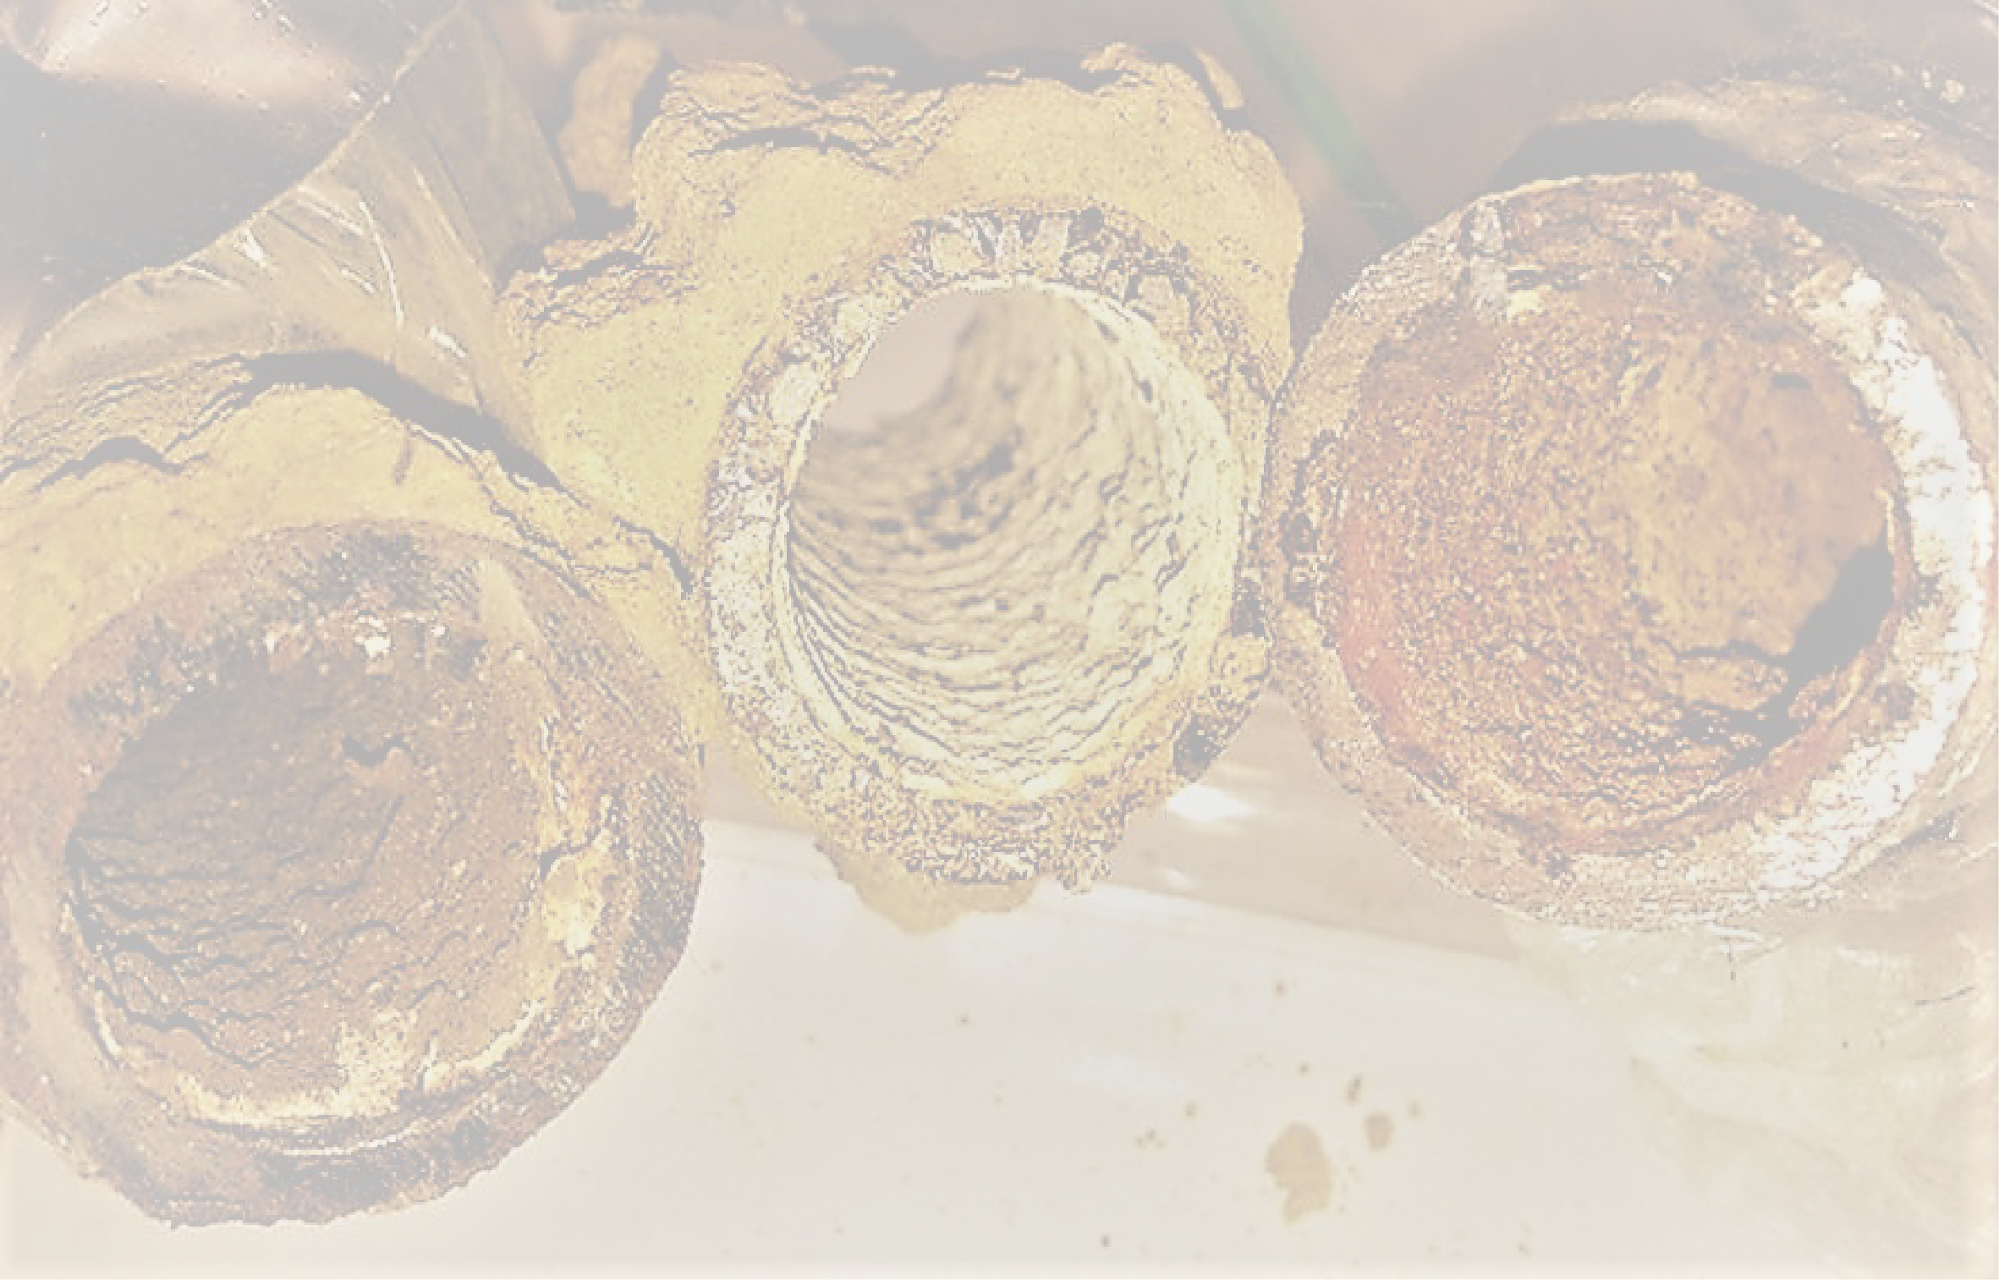
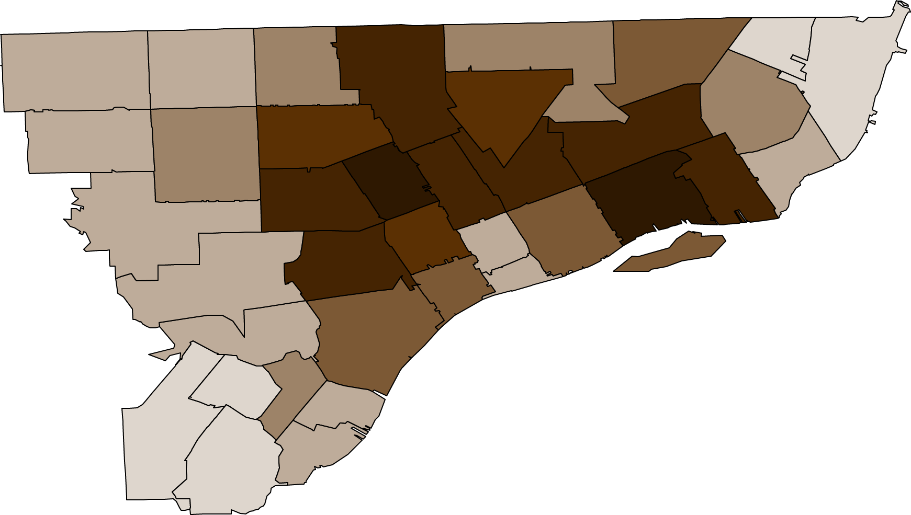
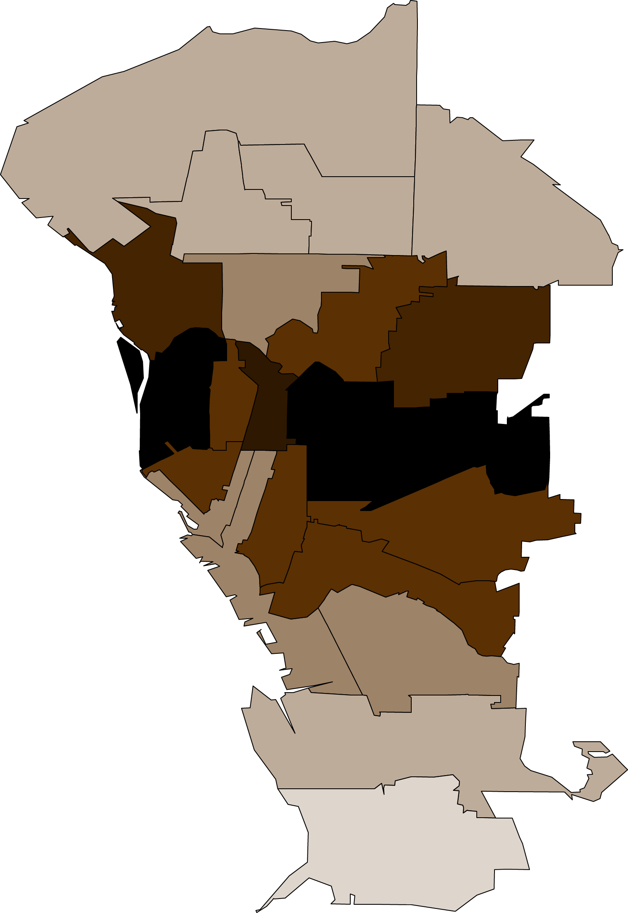
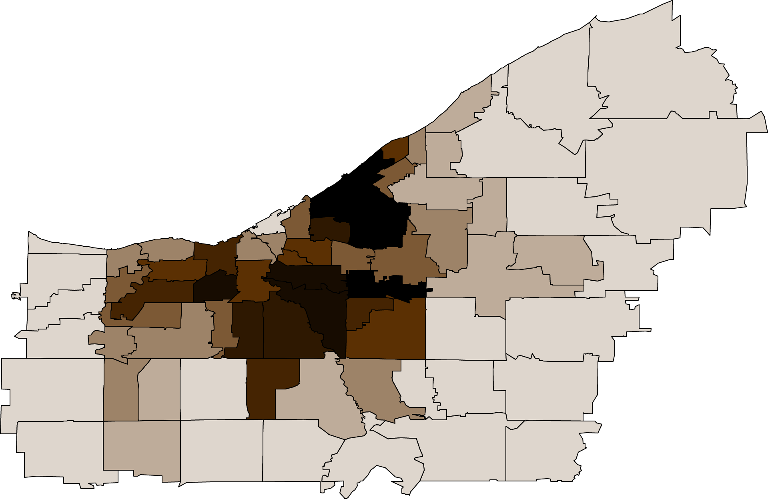
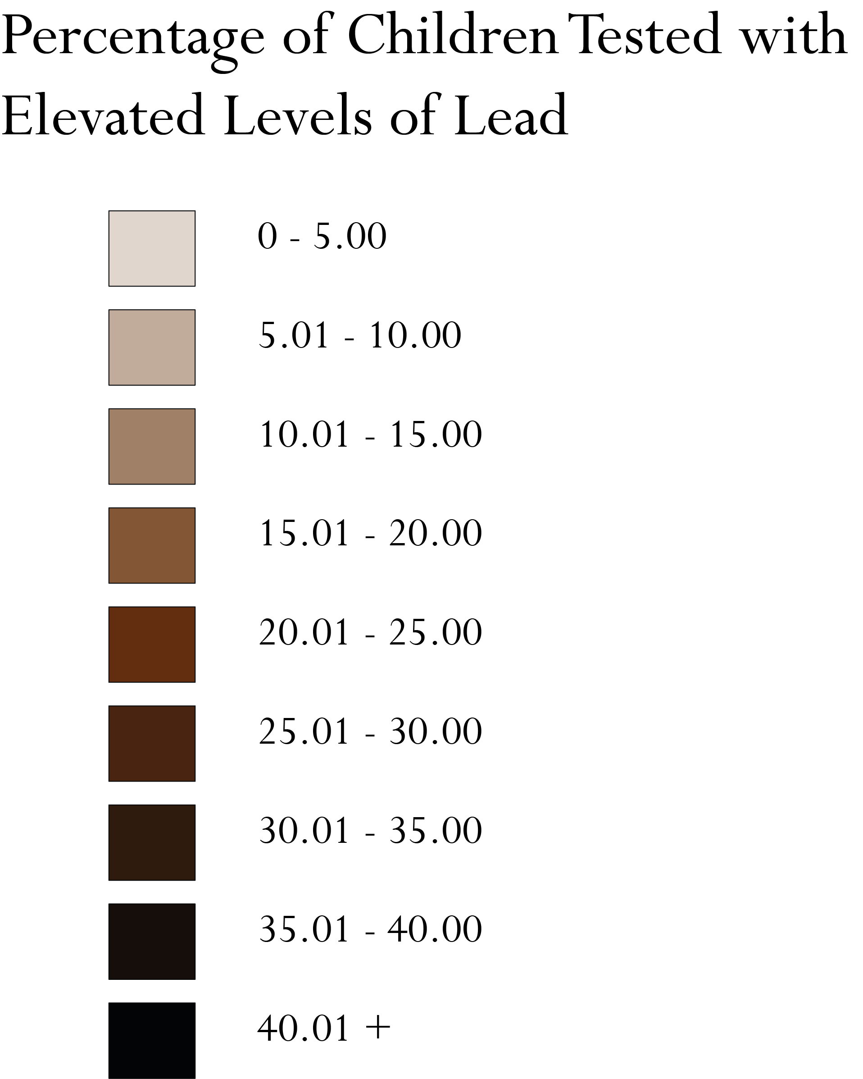
Lead Levels Along the Rust Belt
With the highest percentage of children tested in the state, the Detroit area is home to some of the highest rates of lead exposure in the country. Lead has a particularly dramatic effect on young children, with long-term symptoms that can include a lower IQ, shortened attention span, and increases in violence and antisocial behavior. The neurological and behavioral effects, notes the World Health Organization, "are believed to be irreversible.“ In areas stripped of social services these increased rates can have drastic and lasting implications.
Manufacturing Jobs Lost between 1952 and 2002: 43-56%
Buffalo, New York’s, old housing and high poverty create the perfect conditions for one of the worst childhood lead poisoning problems in the country. In 17 city zip codes, the rate of tested children with high lead levels was at least double that of Flint.
Manufacturing Jobs Lost between 1952 and 2002: >58%
Lead poisoning remains a problem in several Ohio areas, and parts of Cleveland have some of the highest poisoning rates in the US. In some tracts in the St. Clair-Superior area, half of children tested had elevated lead levels, a rate 10 times higher than in Flint, Michigan.
Manufacturing Jobs Lost between 1952 and 2002: >43%
(with more than 58% in some areas)
Jeff Ensworth
Environmental Studies Undergraduate
Source: GIS 2010 Census Data, Reuters
Notes: children tested under the age of six. The CDC estimates that nationwide, around 2.5% of children ages 0-6 have an elevated lead level, defined as 5 micrograms/deciliter or higher

